Slide 1
boston by race
File created on: 21/02/2026 11:27:08 p. m.

Slide 2
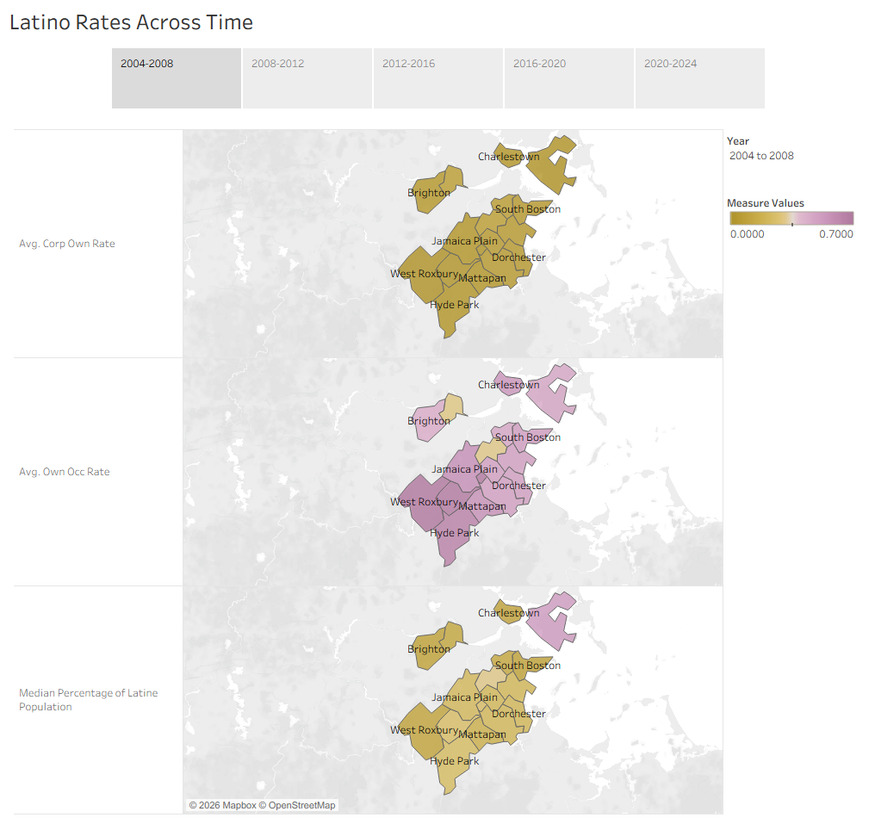

Slide 3
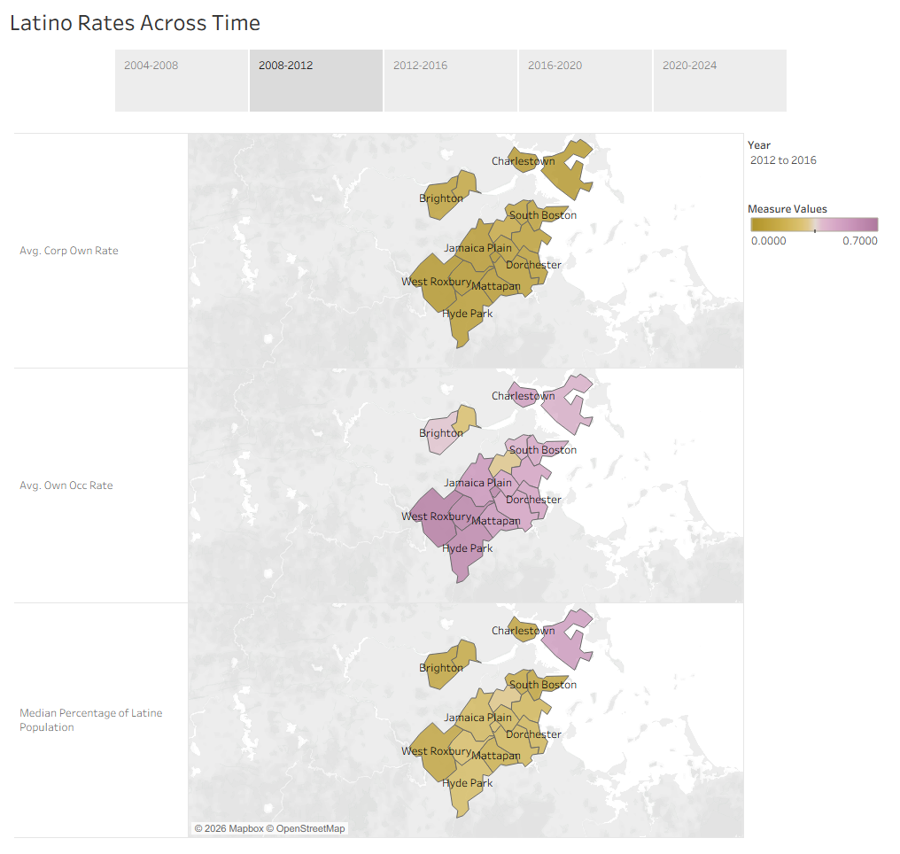

Slide 4
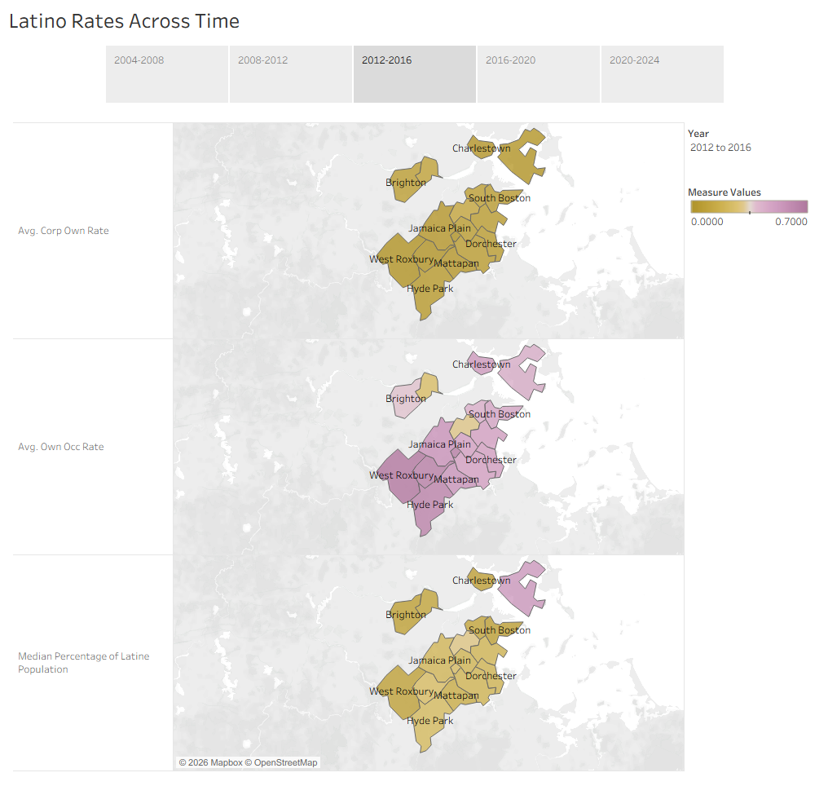

Slide 5
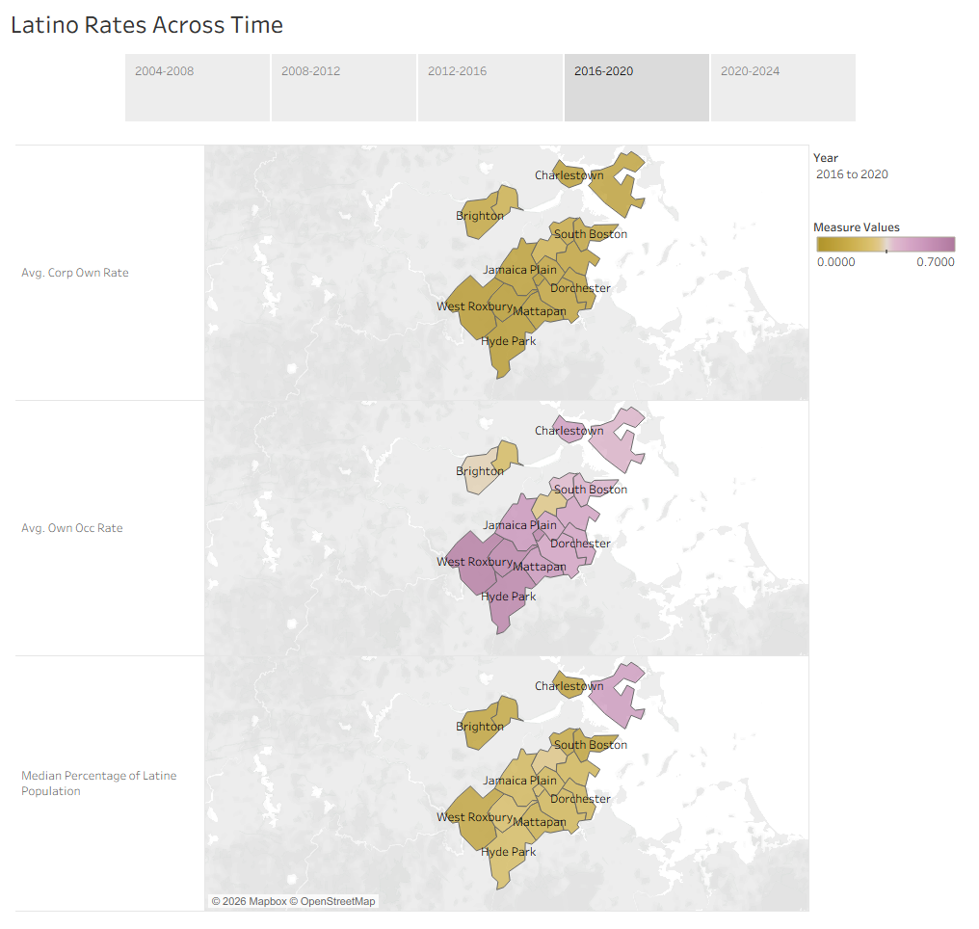

Slide 6
